Slide 1
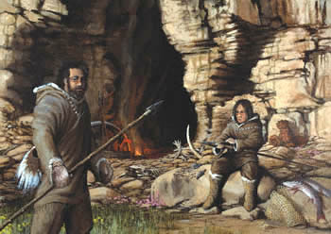
People of the Stone Age
Hunters and Gatherers
Ch.1, Lesson 1
Mr. Bennett’s 6th Grade

Slide 2
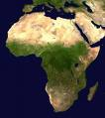
The earliest humans probably lived in Africa.
They spread to the rest of the world over the next tens of thousands of years as they hunted and gathered food to survive.

Slide 3
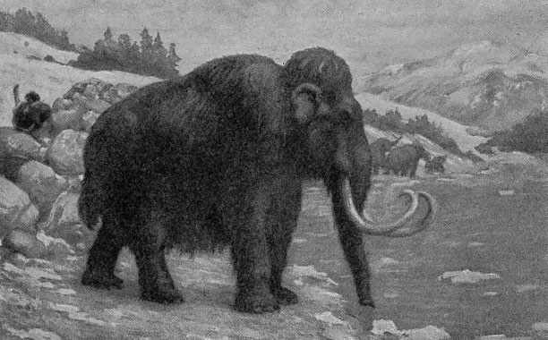
Getting Food

Slide 4


Without becoming food!

Slide 5
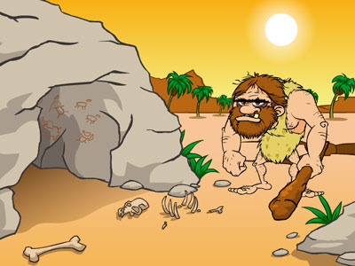
Ugh…Me so
Hungry!

Slide 6
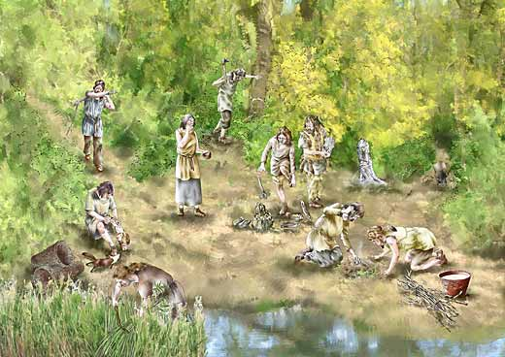
Groups of related families united in bands to collect roots, nuts, fruits and seeds. They also hunted together. By co-operating together they met their basic needs for food, clothing and shelter.

Slide 7
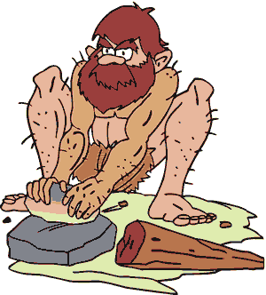

The animals they killed provided meat for food, bones for tools, and hides for clothing.

Slide 8
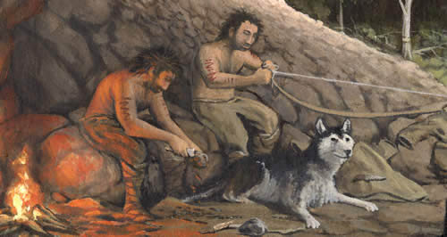
They set up seasonal camps in caves or rock shelters wherever the animals were plentiful.

Slide 9
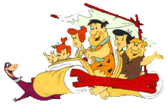
Bands migrated when food (plants or animals) became scarce in one location.
We’re outta here!
Yaba-daba-doo!

Slide 10
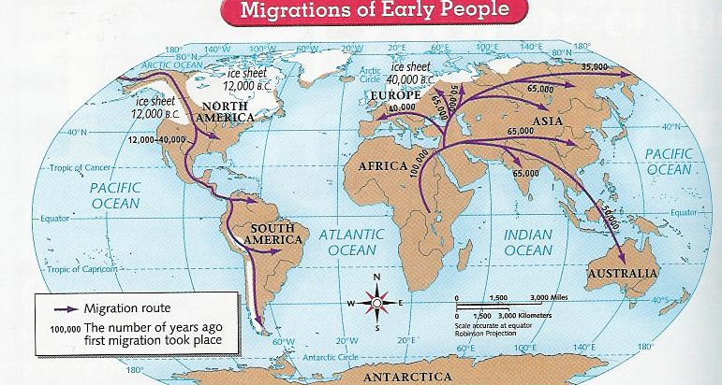
Spreading Through the World

Slide 11

Reasons for the Migrations
Couldn’t find enough food
Growing number of bands
Changing climate (desertification)
Follow animals on the move (hunting)

Slide 12
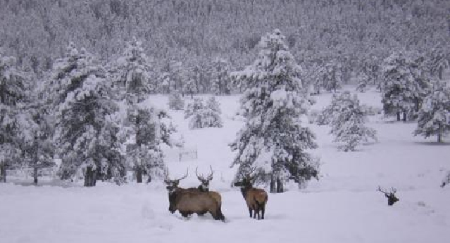
Ice Age
About 35,000 years ago
Ice sheets covered about 1/3 of the earth
Result…ocean level lower & land bridges made
migration to various parts of world
possible

Slide 13
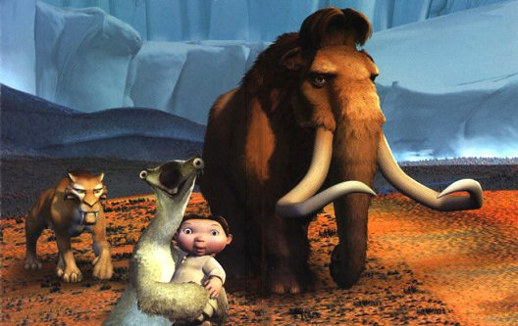
And it made a cool movie too…

Slide 14

Early Cultures
and Societies

Slide 15
People in different parts of the world gradually developed their own cultures (way of life). As bands grew larger, their organization and interactions within the group changed. Band members now performed different tasks (division of labor) and took on different roles according to their abilities and the group’s needs.

Slide 16
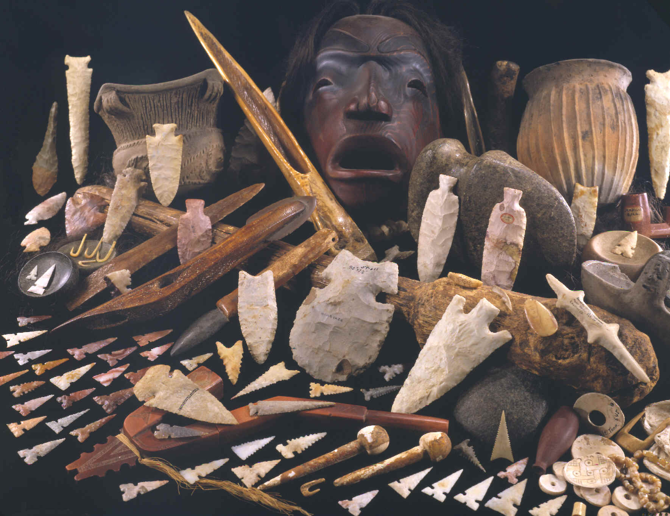
Stone Age Artifacts

Slide 17
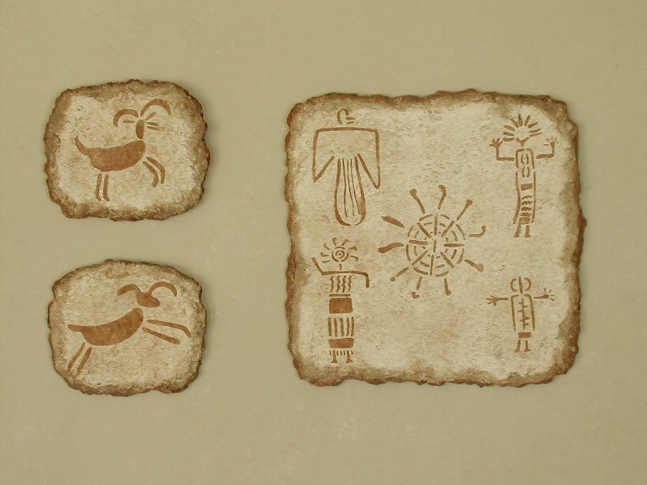
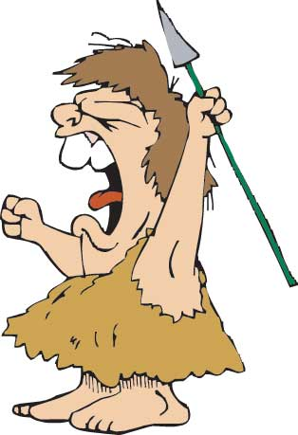
Cave Paintings are Artifacts too.

Slide 18
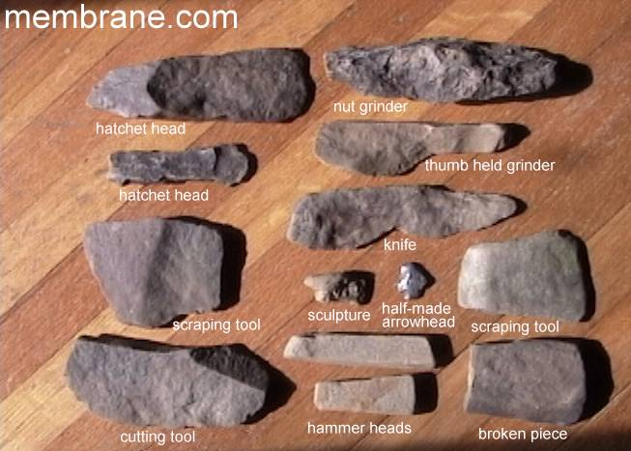
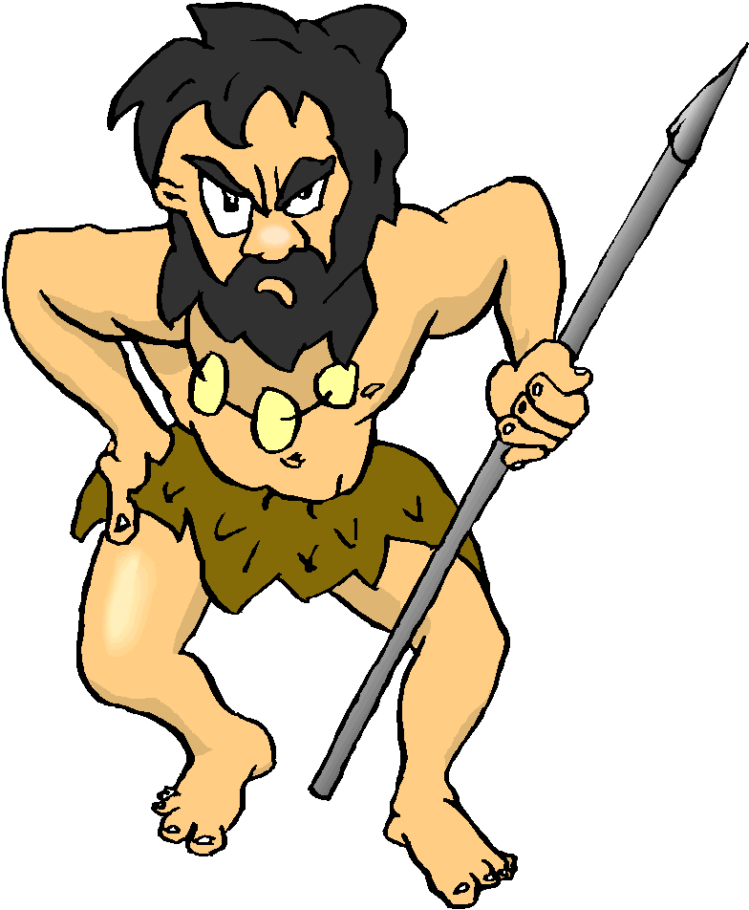

Slide 19

Here we see our good friend, Ugamug, hard at work using his tools.
Watch out for your thumb!

Slide 20
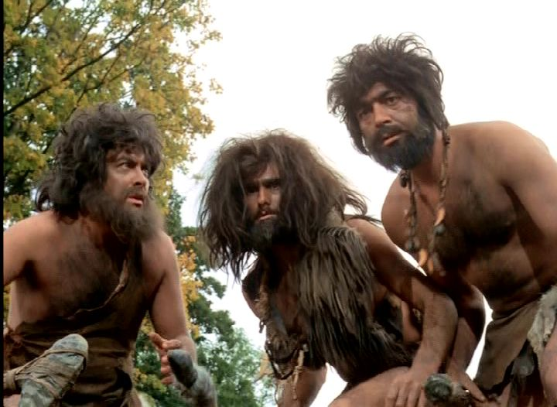
What have we learned?

Slide 21
How did early people get the food they needed to survive?

Slide 22
2. Why did early people work together?

Slide 23
3. Besides food, for what purposes might early people have worked together?

Slide 24
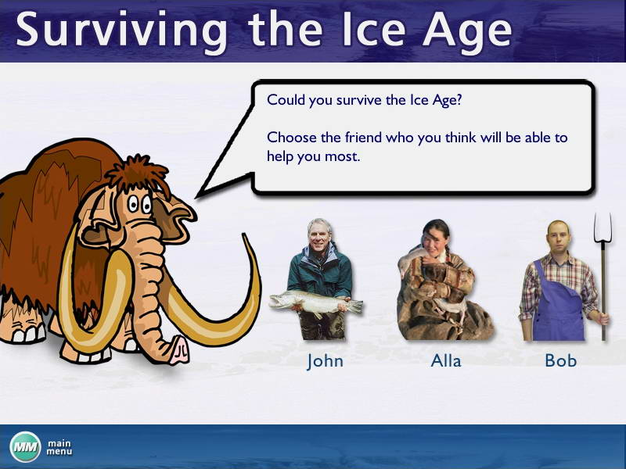

Slide 25
This powerpoint was kindly donated to www.worldofteaching.com
http://www.worldofteaching.com is home to over a thousand powerpoints submitted by teachers. This is a completely free site and requires no registration. Please visit and I hope it will help in your teaching.

